Slide 1
IoT Based Bathroom Occupancy Detection and Status Display System in Heavy Traffic Areas
By Nithin M
Anirudh Saripalli
Parthib Roy

Slide 2
Problem Statement
In many situations, we would have experienced a long wait in the front of a public bathroom- Very irritating right?
Sometimes, if its urgent, we would have to run to another bathroom , maybe again to find that its filled.
What if this thing happens daily with you? With some people, this is the case.
In IIST Hostels, we got 2 shower rooms and 2 toilets each for 16 people of a wing with more than half of the geysers not working and not repaired and the flushes of toilets going for a repair maybe once in 2 weeks.
Some shops won’t have washrooms. Generally, the staff working there would have to travel a few 100m to find a washroom. Generally, they go to nearby restaurants or other public toilets. Imagine walking 100m just to find the washroom being occupied at one place and free at that time in another place.
Airplanes have only 1 or 2 washrooms in economy cabin. Generally, there’s an indicator whether the washroom is filled or not. But the need for occupancy detection exists there also.

Slide 3
Any other public place can face the similar situation if:
Number of people to get serviced is more
They come in bursts.
Number of servicing areas are enough but are distributed in space.

Slide 4
A solution
Detect the occupancy status and display it in a place where all people can see it.
We need to find such common place for display- We use internet- Display the occupancy status of all washrooms of a given area of interest in a website.
New problem: How to detect occupancy status?
Solution: Plenty of ways in literature. We figure out an optimal way.
Where do we see the status: http://bathroomoccupancy-com.stackstaging.com/data/menu1_1.php

Slide 5
Existing Occupancy methods

Slide 6
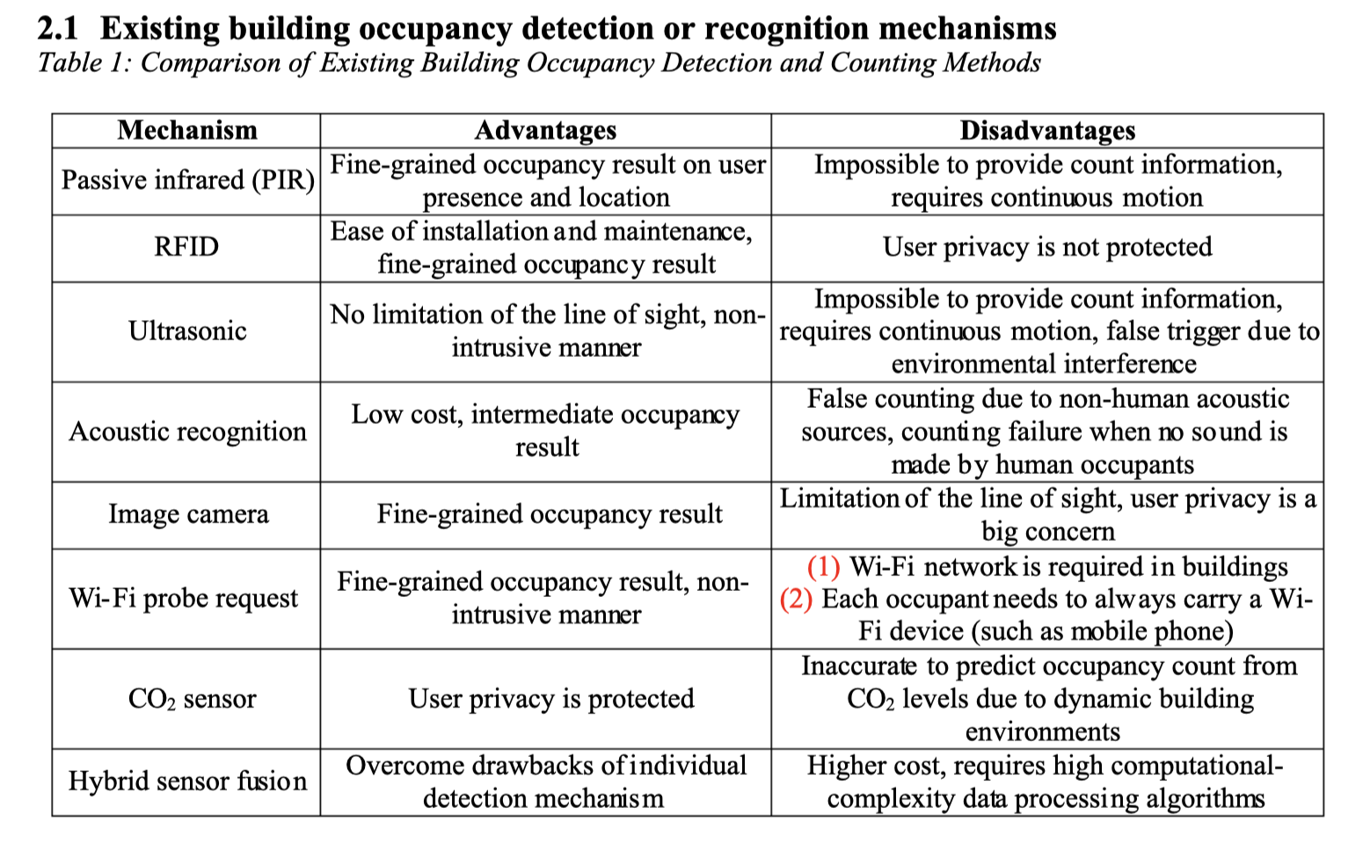

Slide 7
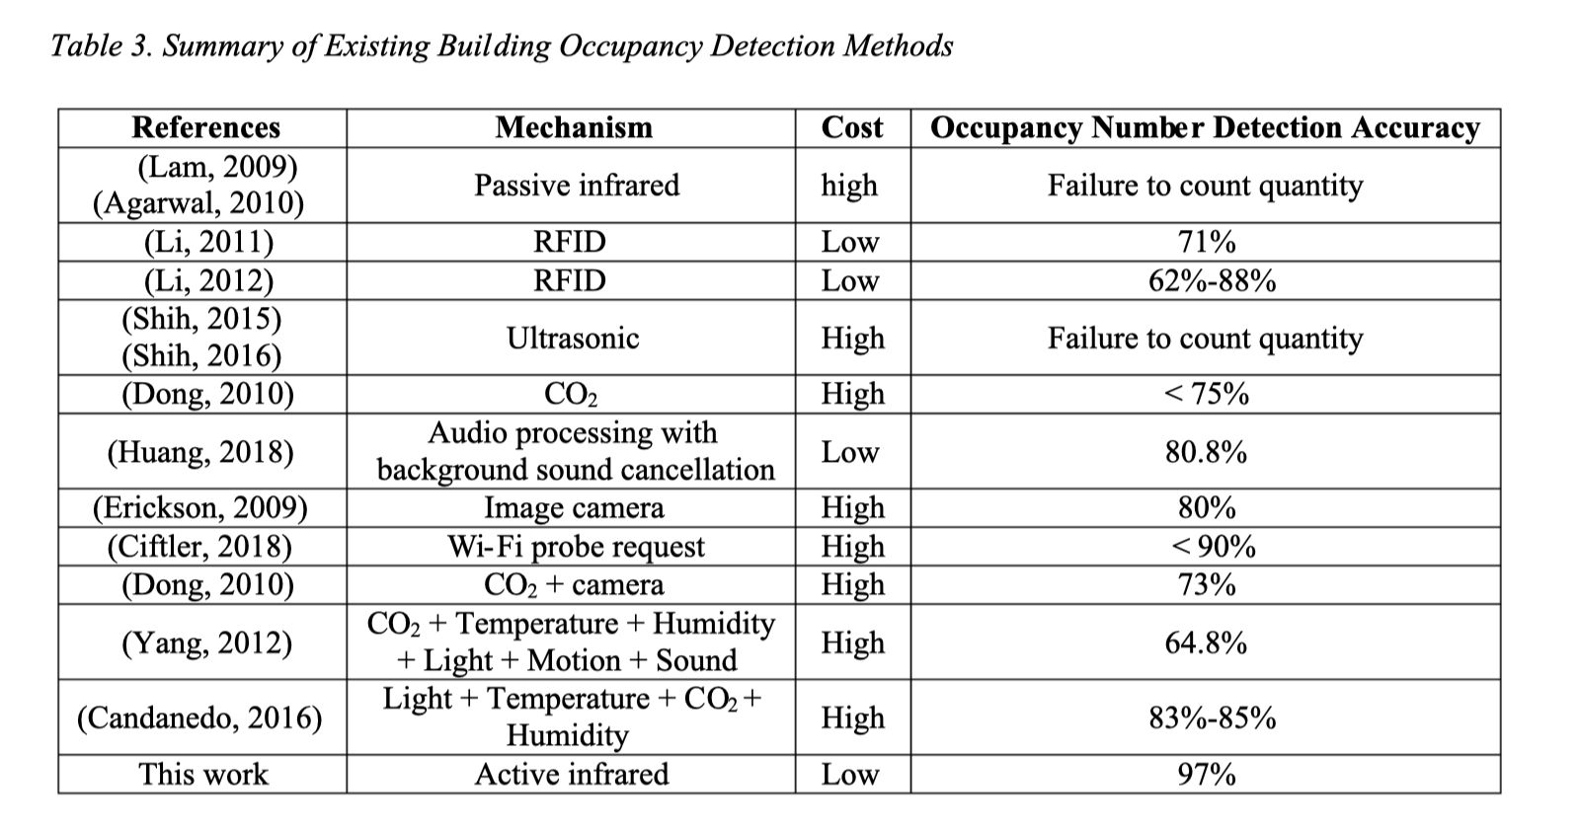

Slide 8
Our Design

Slide 9
Components
Our newly designed tower bolt socket.
A conducting spring.
A cylindrical metallic piece.( A washer would do)
A cuboidal metallic(or non-metallic) piece to place as a lid.
ESP 32 Microcontroller.
A website to display the status.

Slide 10
Modular diagram of the design
ESP-32
Website Database (MySQL)
Website
Each ESP-32 sends the touch-sensor value every 0.5 sec to it’s own database using HTTP.
Database accepts 10 values from ESP-32 and finds the sum.
Sum is compared to the threshold sum value and decision is taken.
The database is erased after every 10 readings.
Refreshing manually will show the current status of each bathroom
Updating time was observed to be 10-20 sec.

Slide 11
Database structure
Bathroom-1
Bathroom-2
Bathroom-3
Bathroom-4
Value_table_1
Value_table_2
Value_table_3
Value_table_4
Decision taken by PHP file of each database (each bathroom) and updated on the website independently.

Slide 12
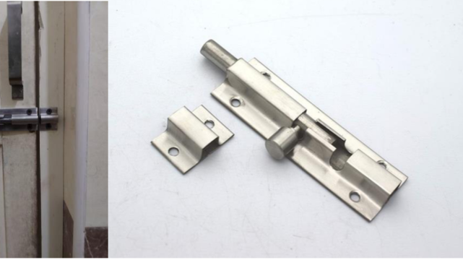
The tower bolt
We modify this

Slide 13
Design of the tower bolt’s socket

Slide 14
Design of support for spring

Slide 15
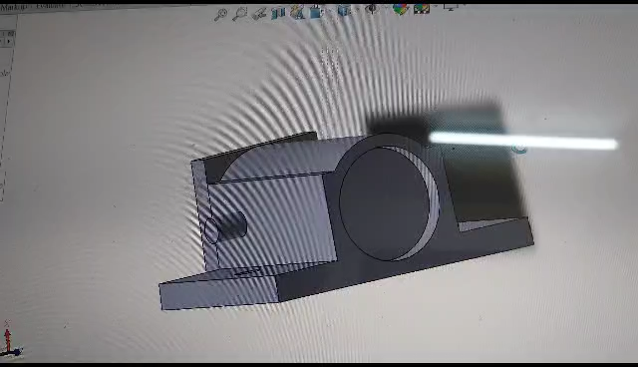
3D model of socket

Slide 16
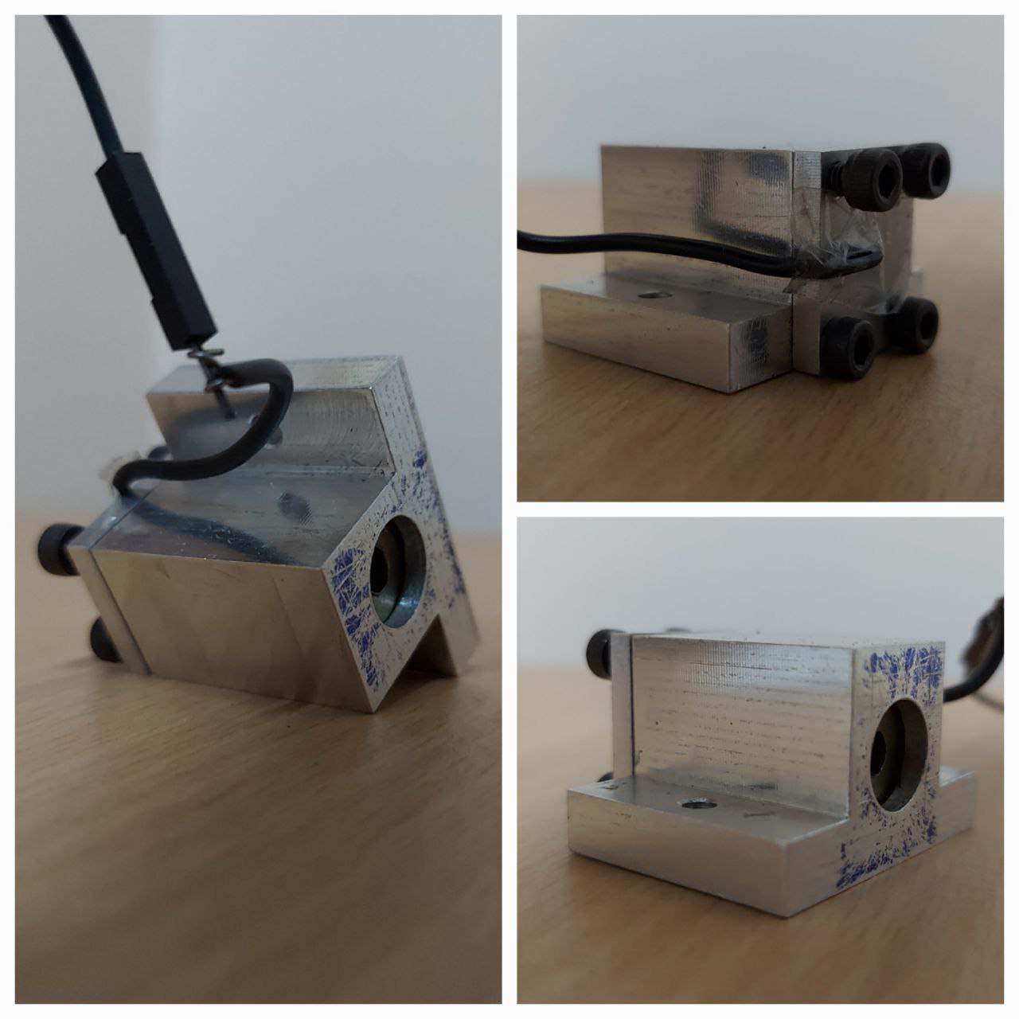
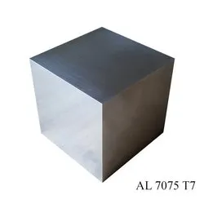
Socket Design and Process in brief
Made from Aluminium.(Results vary if a dielectric or insulator was used)
With the given measurements, do the following.

Slide 17
The given block was shaped into the form of the bolt.
It was polished.
A hole was drilled in the center with 2 diameters(13mm and 10mm) as shown.
A milling machine was used for 1 and 3.
4 holes each of 10mm for m3 bolts were drilled.
Then threading was done.

Slide 18
Again, aluminium was shaped to form the lid as shown with thickness= 3mm
5 holes drilled throughout.
4 of them for bolts and 1 for wire to go in and sense the touch.
A spring of outer diameter 12mm and free length 25mm and thickness of coil = 5mm was made from stainless steel.
A washer of diameter 12mm was bought.
We needed m3 bolts 10mm deep. We got only 20mm m3 bolts. This was cut using a saw and smoothened to 10mm.
Assemble as shown.

Slide 19
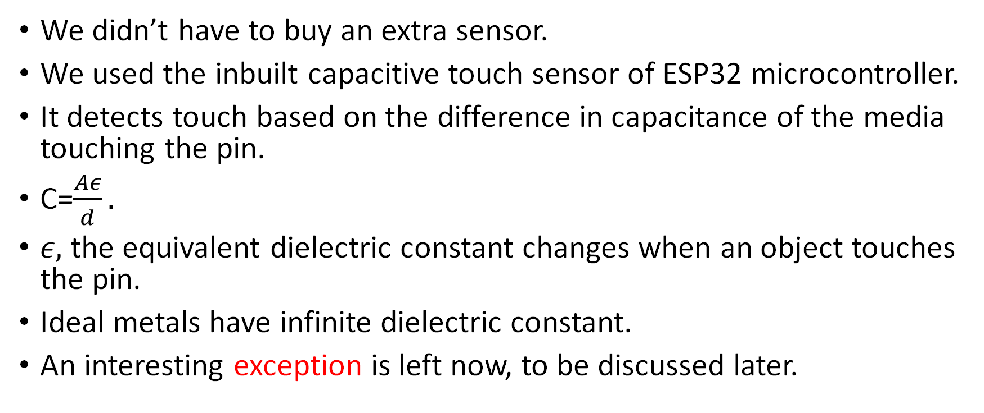
Physical Principle of Sensor
We didn’t have to buy an extra sensor.
We used the inbuilt capacitive touch sensor of ESP32 microcontroller.
It detects touch based on the difference in capacitance of the media touching the pin.
C=$\frac{Aε}{d}.$
$ε,$the equivalent dielectric constant changes when an object touches the pin.
Ideal metals have infinite dielectric constant.
An interesting exception is left now, to be discussed later.

Slide 20
In our case, the wire from pin D4 which goes into the hole of the lid to touch the conducting spring, which in turn touches the metallic washer. This touch is assigned a particular value on a default scale of 100 where a reading above 90 is observed when the touch pin is in contact with an insulator or air or a material with dielectric constant very near to air’s dielectric constant(happens the touch pin is left freely to rest somewhere).
When the bolt comes in contact with the washer, this touch value changes. Using a suitable threshold, we can decide whether the door is closed or open. The case of partial locking is tackled with the help of spring.
We can think of the situation as dielectrics in series. When a new contact occurs, a dielectric gets added in series instead of air or equivalently there is a capacitance increase.

Slide 21
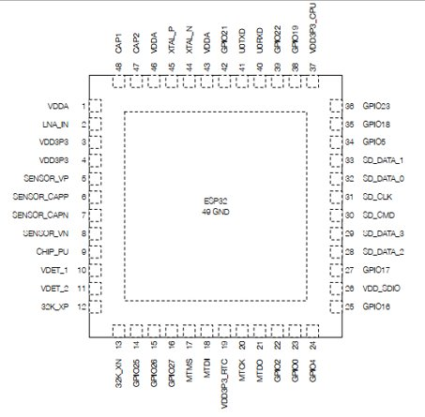
ESP 32 Microcontroller

Slide 22
Interfacing with microcontroller and website
Arduino code
Arduino code for In-built touch sensor in ESP32 board is as follows,-
// ESP32 Touch Test
// Just test touch pin - Touch0 is T0 which is on GPIO 4.
const int LED_BUILTIN = 2;
const int touchPin = 4;
const int threshold = 40;
int touchValue;

Slide 23
void setup() {
Serial.begin(115200);
delay(1000); // give me time to bring up serial monitor
Serial.println("ESP32 Touch Test");
pinMode (LED_BUILTIN, OUTPUT);
}
void loop() {
touchValue = touchRead(touchPin);
Serial.print(touchValue);
if (touchValue < threshold){
digitalWrite(LED_BUILTIN, HIGH);
}
else {
digitalWrite(LED_BUILTIN, LOW);
}
delay(500);
}

Slide 24
PHP code - interfacing Arduino client with the server database
Decision rule – update status

Slide 25
Demonstration of working
One-microcontroller setup
3-microcontroller setup

Slide 26
Advantages
More modular. Can be applied to any door.
Maybe the simplest.
Best suited for public restroom applications where we’re almost sure that the door will be locked while in use.
Avoids long wires which the existing methods use.
Cheaper.(Actually very much)
Long life: After attaching to any restroom door, the chances of our setup getting damaged is very low since its inside the pocket.
Easier maintenance: Components are easier to replace.

Slide 27
Limitations and some possible solutions
Limited for tower bolt system with non-insulating bolts.
While testing, it was observed that the microcontroller’s touch sensor reads very random values after 5h of continuous operation. One or 2 in every 5 observations would be correct, but then the sum threshold comparison method fails. A reason for this would be the thermal noise generated which increases with time. This issue got resolved after we switched off the microcontrollers for 2h.
We haven’t provided any isolation for the socket.
When the surroundings change, its observed that there is a need to change the threshold assigned for the given sum algorithm. This issue may be resolved by better algorithms or by machine learning methods, which can be used to set the threshold automatically for say every 1h duration. (We tested comparing minimum and maximum values and using mode, but sum was better since data was generally found clustered around a central point).
The inbuilt capacitive touch sensor has a limited sensitivity. This invokes the need for data analysis. A similar sensor with higher sensitivity could be used.
ESP32 Touch Sensor has not passed the Conducted Susceptibility (CS) test for now, and thus has limited application scenarios.

Slide 28
Comparison with PIR sensor
PIR sensors require a direct line of sight between the sensor and occupants in a space.
Thus, for accuracy, we might need multiple such sensors located at different areas of washrooms so to detect people with different heights.
Lack of fine-grained detection: PIR sensors are primarily designed to detect large movements, such as a person walking across a room. They are less effective in detecting small or subtle movements, such as someone sitting still or slight body movements.
Relatively costly.

Slide 29
Comparison with ultrasonic sensor
Ultrasonic sensors cover the entire space and do not need a line of sight. As a result, they can detect people behind obstacles. They also are more sensitive to minor motions, such as hand movements.
However, they rely on reflections.
Reflective surfaces and multiple reflections will lead to false detection.
Costly than PIR and our method, however more accurate than PIR.

Slide 30
Comparison with CO2 sensor
CO2 based sensing appears another nice and accurate way to detect human presence.
Positioning of the sensor maybe an issue in the presence of exhaust fans or other ventilation windows.
These sensors can be based on various technologies, such as non-dispersive infrared (NDIR) sensors or electrochemical sensors. Thus, costly.

Slide 31
Methods like RFID, image camera, acoustic recognition and wifi-probe request can reveal a user’s identity and privacy concerns will be an issue.

Slide 32
Future Plans
Implement the same system with a plastic or polymer which is not a good conductor of electricity and test the performance.
We need to decide upon the best material for each component.
We need to find a way to make our sensor environment independent.
Location details of washroom may be added for larger areas of concern.
Plans about website improvement.

